Slide 1
Osher Lifelong Learning Institute, Fall 2026
Contemporary Economic Policy
University of Hawaii, Manoa
Host: Jon Haveman, Phd
Executive Director
National Economic Education Delegation

Slide 2
National Economic Education Delegation
Vision
  One day, the public discussion of policy issues will be grounded in an accurate perception of the underlying economic principles and data.
Mission
  NEED unites the skills and knowledge of a vast network of professional economists to promote understanding of the economics of policy issues in the United States.
NEED Presentations
  Are nonpartisan and intended to reflect the consensus of the economics profession.

Slide 3
Who Are We?
Honorary Board: 54 members
  2 Fed Chairs: Janet Yellen, Ben Bernanke
  6 Chairs Council of Economic Advisers
    Furman (D), Rosen (R), Bernanke (R), Yellen (D), Tyson (D), Goolsbee (D)
  3 Nobel Prize Winners
    Akerlof, Smith, Maskin
Delegates: 652+ members
  At all levels of academia and some in government service
  All have a Ph.D. in economics
  Crowdsource slide decks
  Give presentations
Global Partners: 48 Ph.D. Economists
  Aid in slide deck development

Slide 4
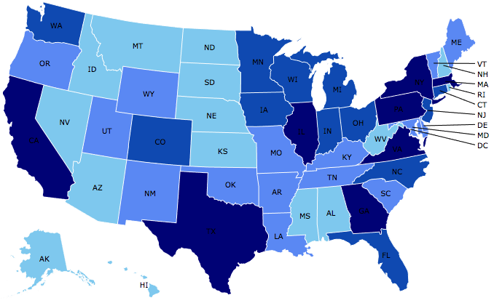
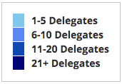
Where Are We?

Slide 5
Available NEED Topics Include:
US Economy
Healthcare Economics
Climate Change
Economic Inequality
Economic Mobility
Trade and Globalization
Minimum Wages
Immigration Economics
Housing Policy
Federal Budgets
Federal Debt
Black-White Wealth Gap
Autonomous Vehicles
US Social Policy

Slide 6
Course Schedule
Contemporary Economic Policy
  Week 1 (10/23): Economic Update, Geoffrey Woglom, Amherst College
  Week 2 (10/30): The Economics of Tariffs, Tibor Besedes, Georgia Institute of Technology
  Week 3 (11/06): Economic Mobility, Joseph Carolan, Oakland University
  Week 4 (11/13): The New, New Inequality, Geoffrey Woglom, Amherst College
  Week 5 (11/20): Health Care Economics, Robert Rebelein, Vassar College

Slide 7
Submitting Questions
I encourage questions. Please put questions in the chat and I will answer them periodically during the talk,
We will do a verbal Q&A once the material has been presented.
Slides are available from the NEED website https://needecon.org/delivered_presentations.php.

Slide 8
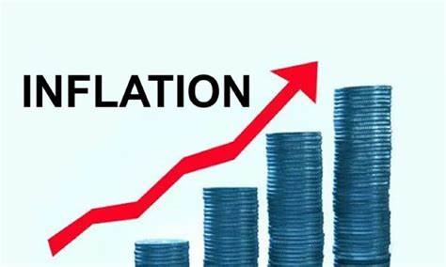
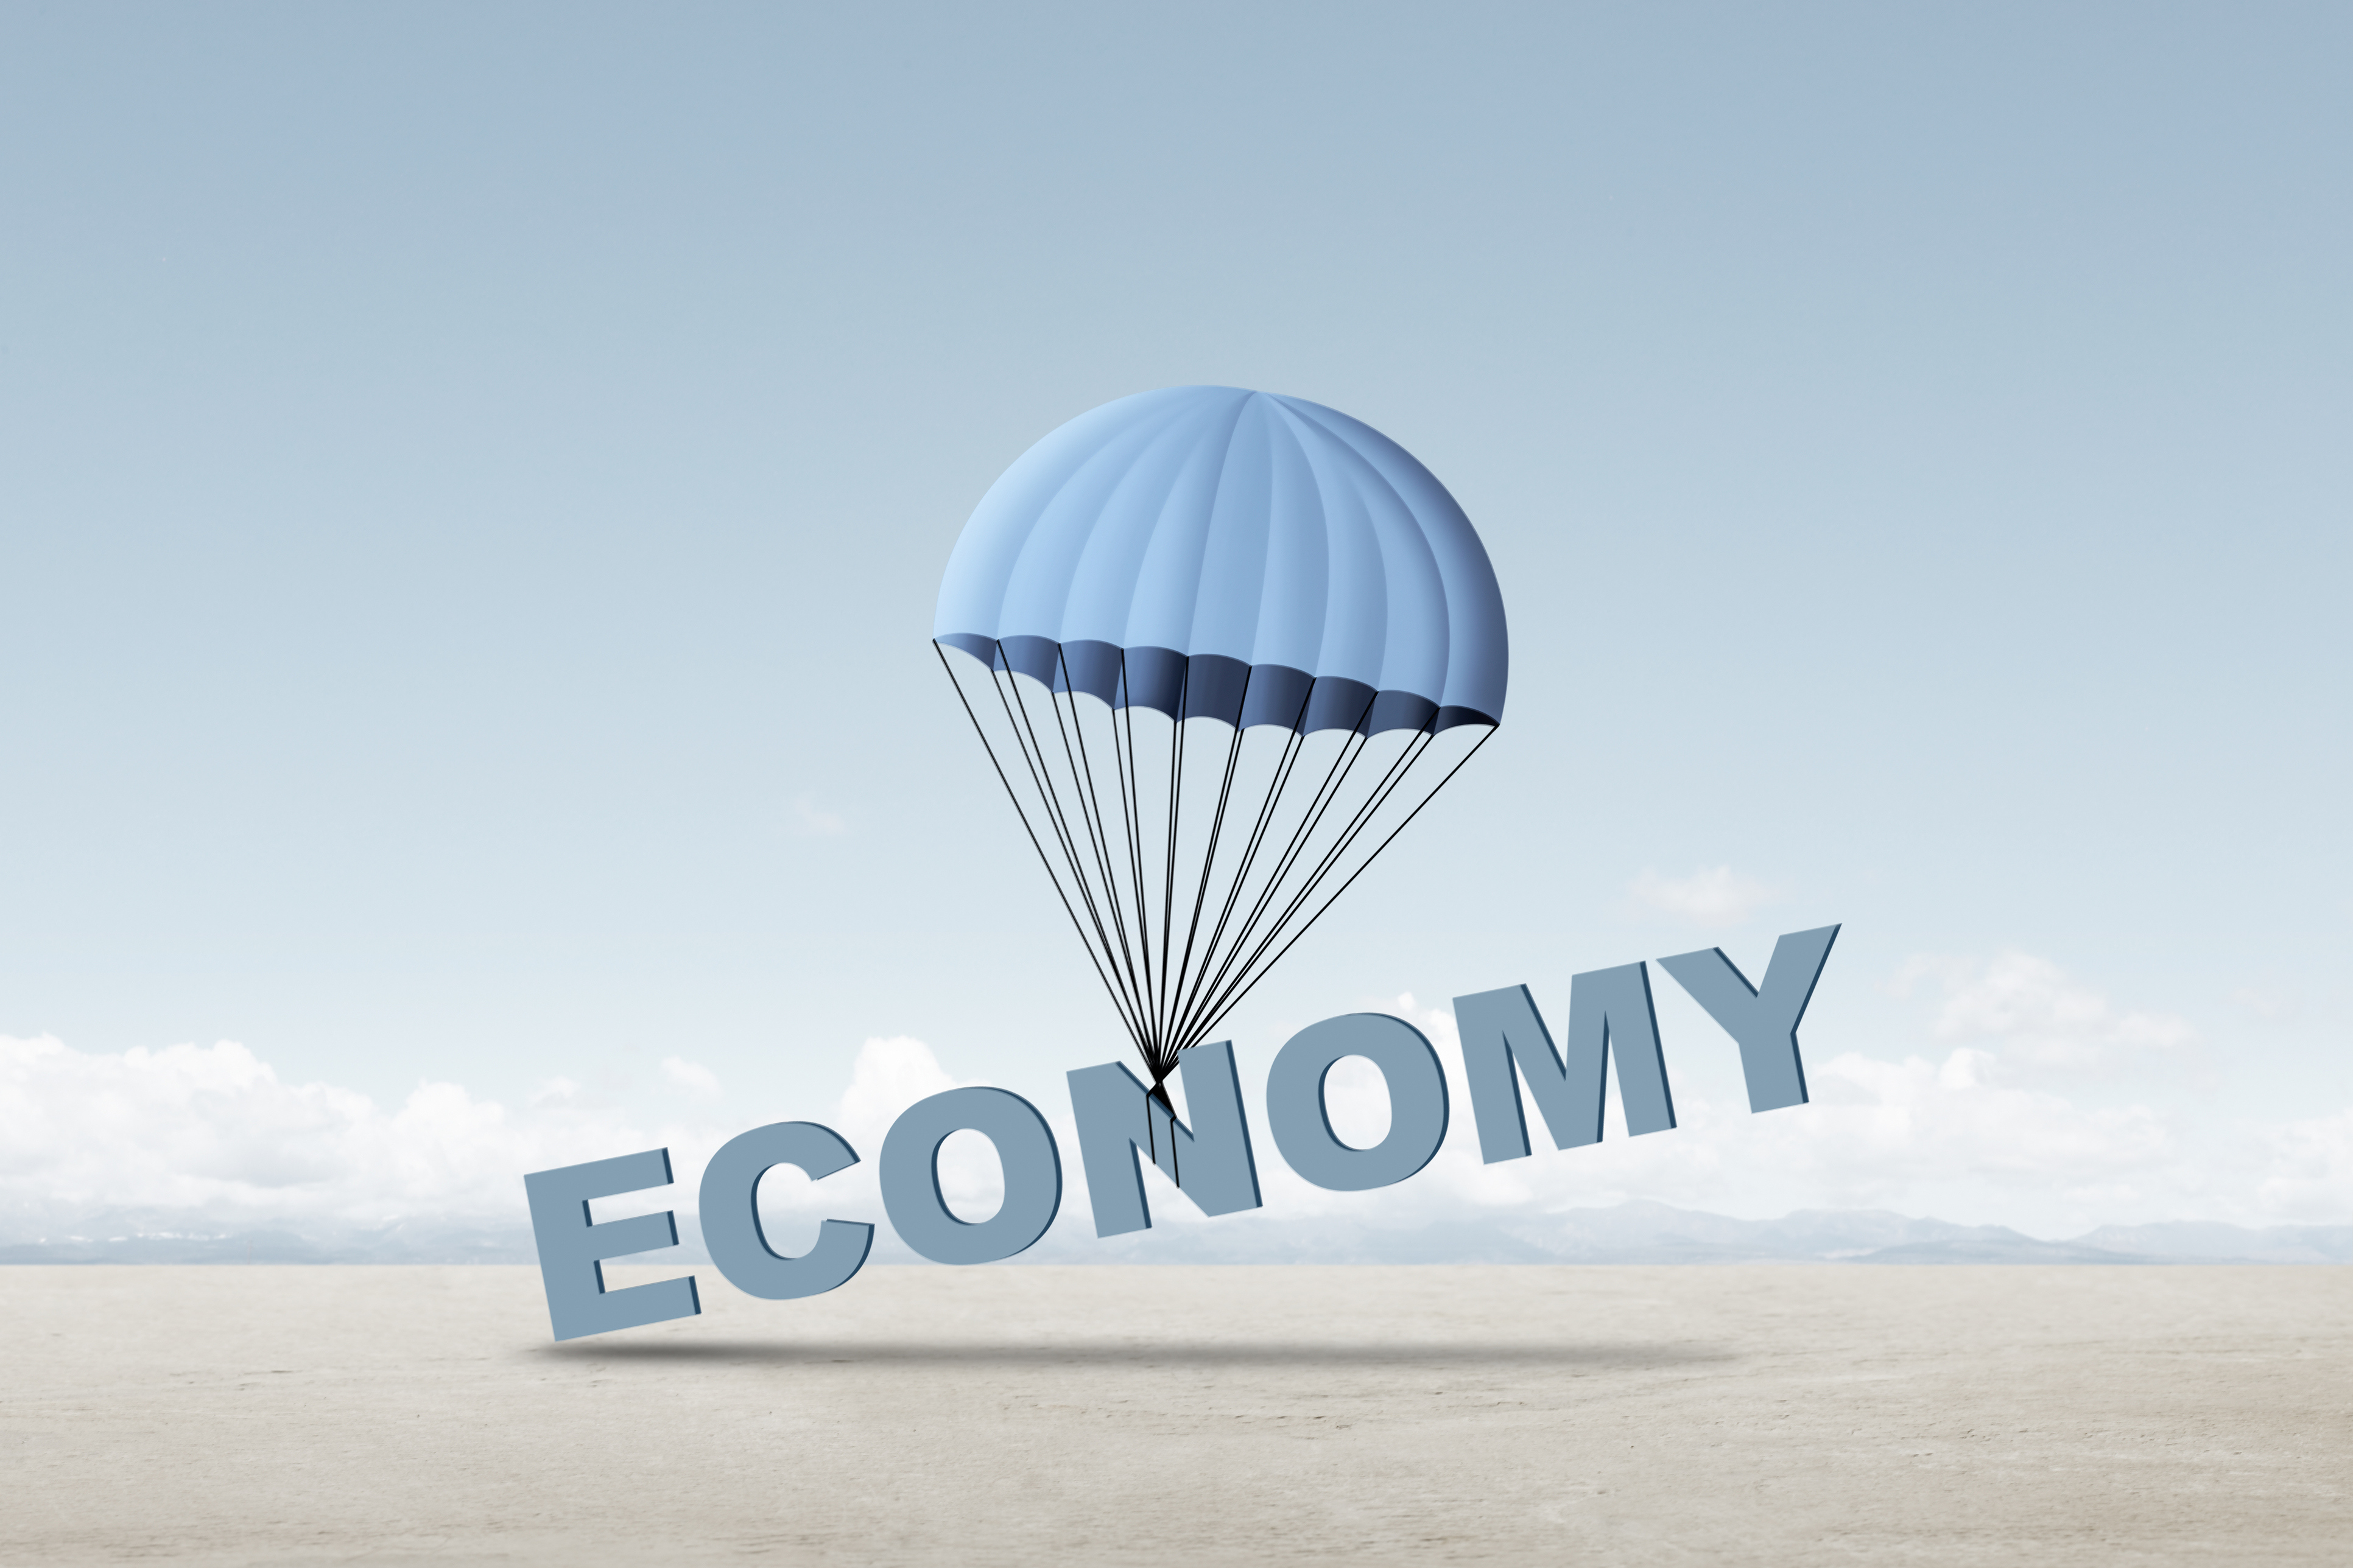
US Economy: Update
&
The Recent Rise in Interest Rates
Geoffrey Woglom,
Professor of Economics
Amherst College, emeritus
October 23, 2026

Slide 9
Outline for the Talk
Part 1
Overview of State of the Economy: Remarkable resilience in the face of wars, oil prices & tariffs, but worrying signs.
Major uncertainties going forward, particularly AI
Part 2
The Runup in World Wide Interest Rates.
Why This is Important.
How to Read the Messages in Rising Interest Rates

Slide 10
Judging the State of the Macroeconomy
The Fed’s Definition:
Get the economy to the highest levels of output (GDP) and employment, while
Keeping inflation low and stable, or at 2%
What about the climate change; poverty, health care?

Slide 11
Gross Domestic Product: 2026Q2 = $32.6 tr
$33.4
Less Imports
-$4.7
Plus Exports
+$3.8
Equals GDP
$32.6

Slide 12
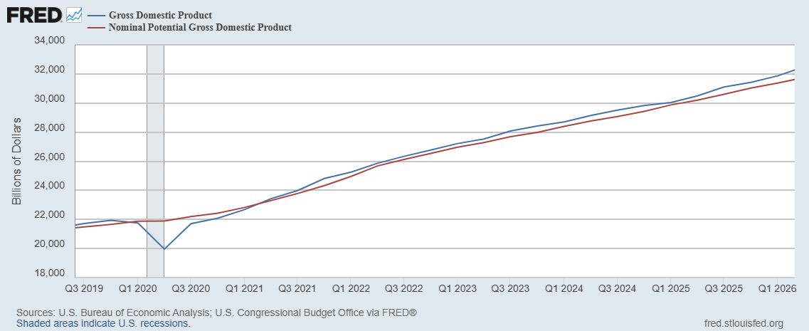
GDP and ‘Potential’ during the Recovery
Grey bar indicates recessions
Source: Fred, St Louis Fed

Slide 13
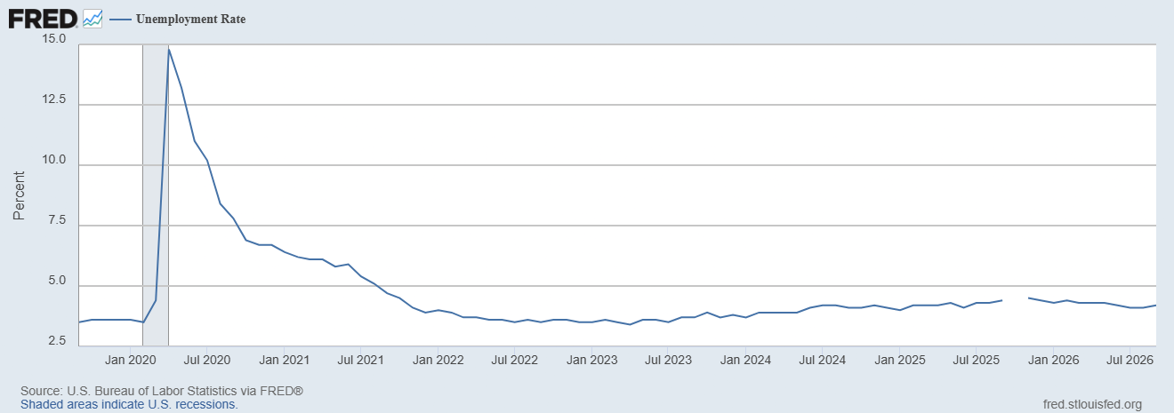
Unemployment is Near Record Lows

Slide 14
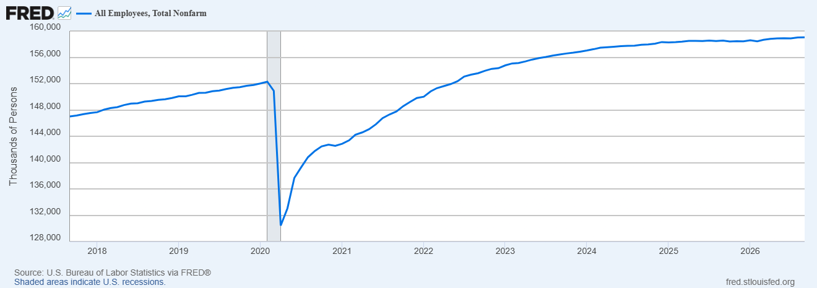
Where Have All the Workers Gone?
Aging of the Labor Force
Also, note the recent slowing in job growth.
Source: Fred, St Louis Fed

Slide 15
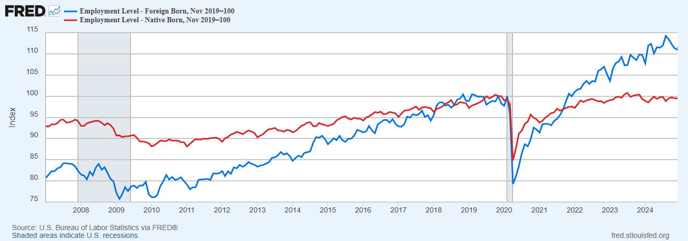
Could Have Been Worse , but for Foreign Born Workers
Between 12/19 and 4/25
NB employment flat
FB employment rose by 5000k
Since 4/25 FB employment
fell by 1000k; NB constant

Slide 16
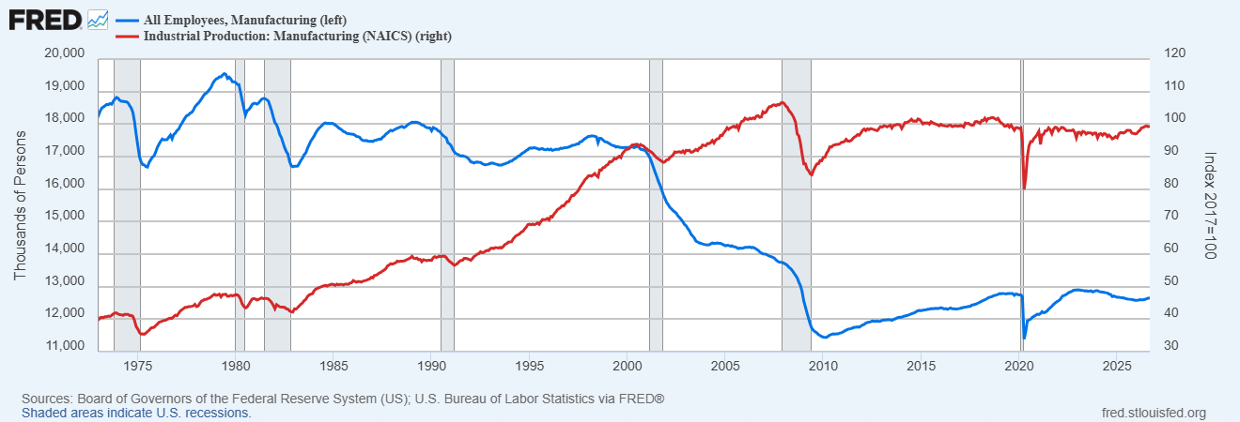
What About Manufacturing?

Slide 17
The Real Side of the Economy is Still Good
GDP is very close to its potential.
The labor market as measured by the unemployment rate is fully recovered.
Macro Goal number 1, check
But what about goal number 2, the “nominal” side of the economy

Slide 18
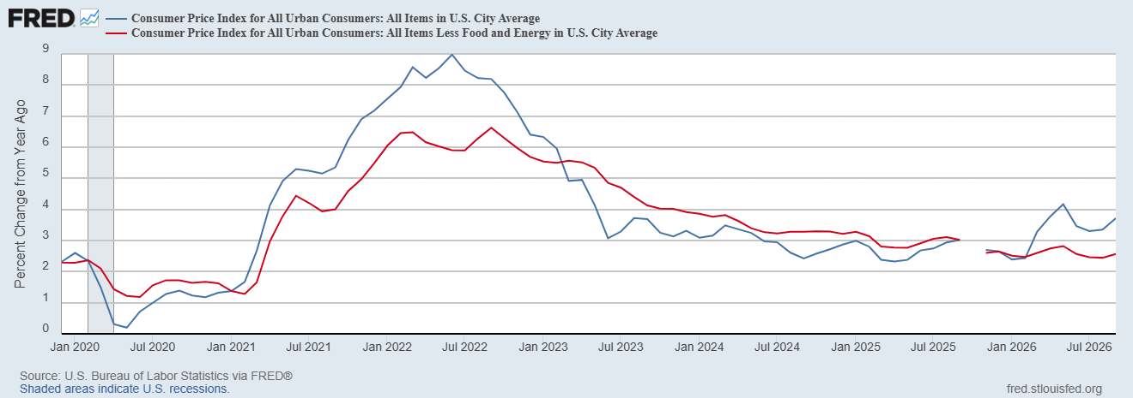
CPI Inflation
Notes:
August CPI yoy 8.3% down from 8.5 and Core 6.3 up from 6.3 in JUly

Slide 19
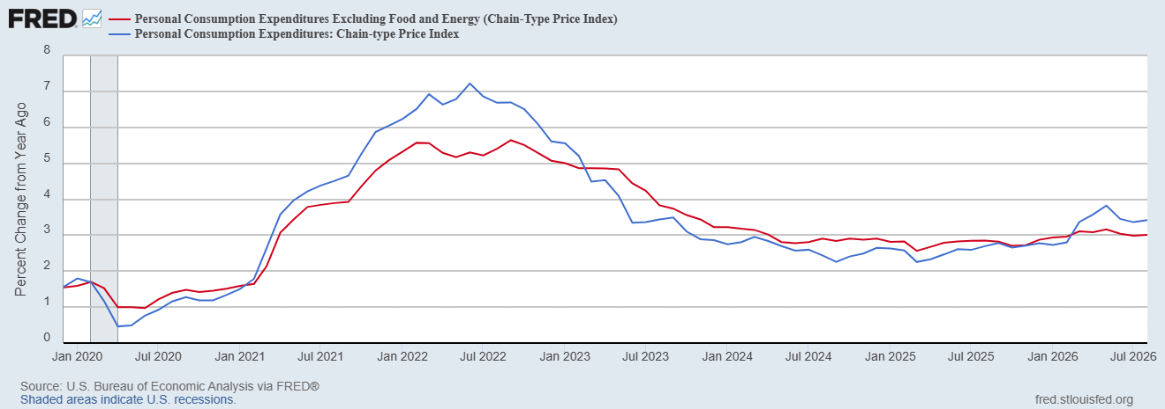
Fed’s Measure (PCE)
Inflation Accelerates 3/2021
Fed Doesn’t React until 3/2022
Progress towards the 2 % slows Spring 2024

Slide 20
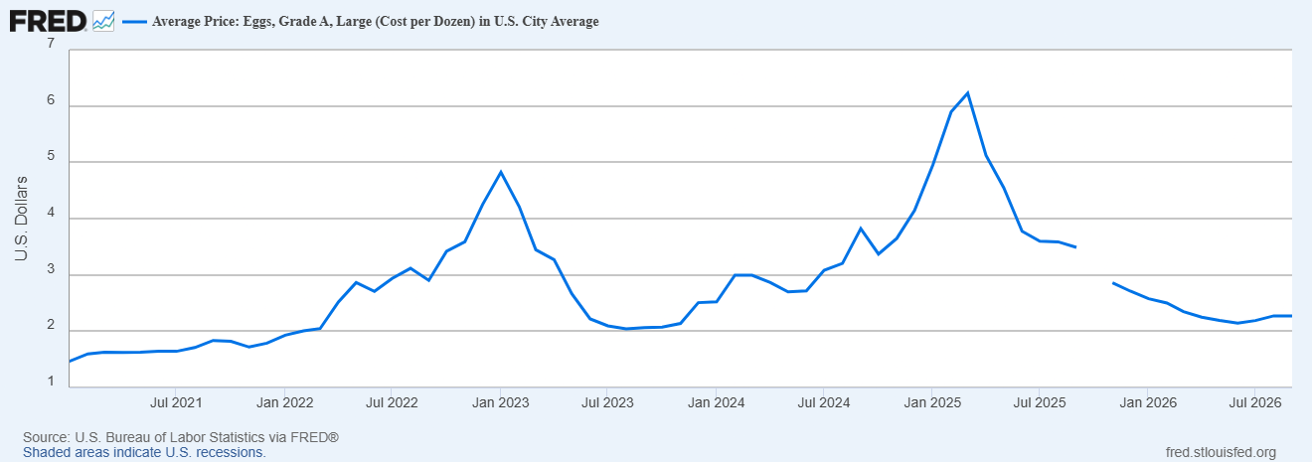
Uses of Inflation Measures
Two Reasons for Measuring Recent Inflation:
What has happened to the Cost of Living?
What is likely to happen to inflation over the next 12-18 months?

Slide 21
Measures of Underlying Inflation (?)

Slide 22
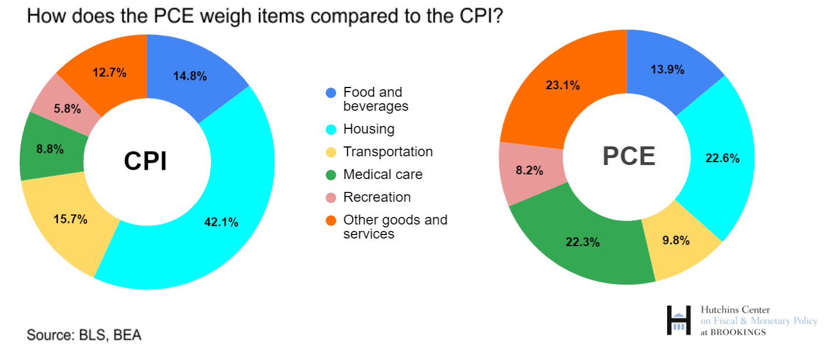
CPI vs. PCE: Differences
CPI typically tends to be 0.3 pct point higher
Aug:
CPI, 3.4%
PCE, 3.4%
Core CPI, 2.4%
Core PCE, 3.0%.
https://www.brookings.edu/articles/how-does-the-government-measure-inflation/

Slide 23
“Affordability”
Notes:
148 129 131 127 126.5

Slide 24
Three Measures of Cost of Housing Inflation
Notes:
87,32,30

Slide 25
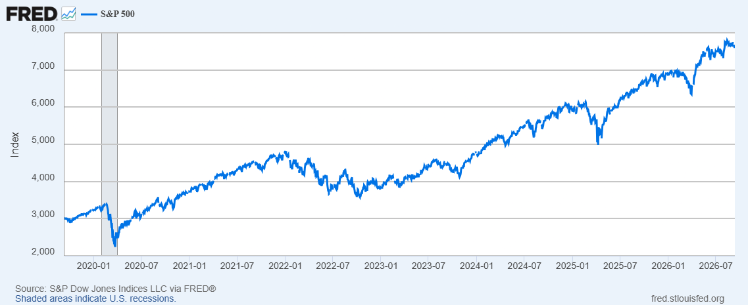
Stock Prices: Tariffs, What Tariffs; War, What War?
Notes:
Since the end of 2021, lost almost 15%

Slide 26
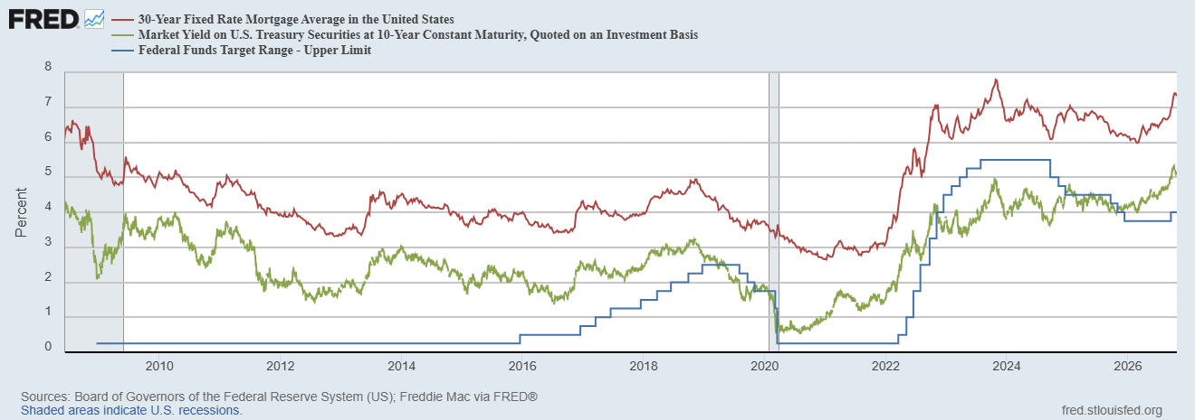
Interest Rates: Era of Falling Rates Over?
Notes:
3 Things: 1.

Slide 27
The State of the Economy & the Future
The key indicators for judging the macro economy are still good
  Output and unemployment are close to their “full employment” levels,.
  Inflation is still elevated, but some of this is due to “price shocks.”
Concerns
  K-shaped growth.
  Is the AI boom sustainable?
  Price shocks may get worse due to war in Iran.

Slide 28
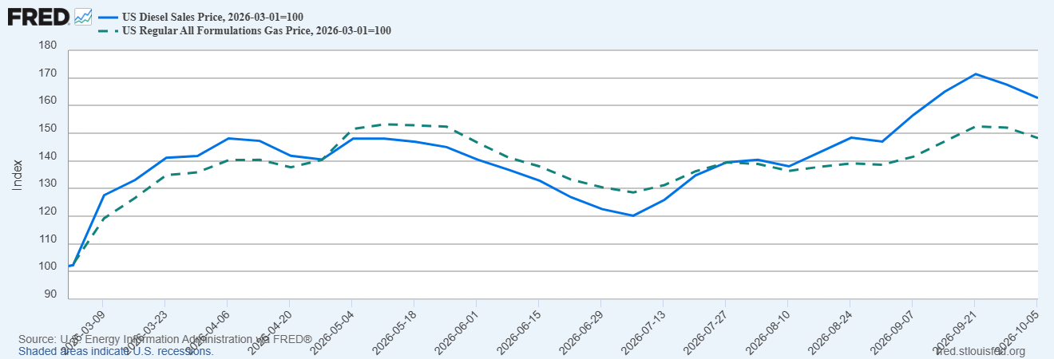
The Rise in Diesel is Bigger & More Inflationary

Slide 29
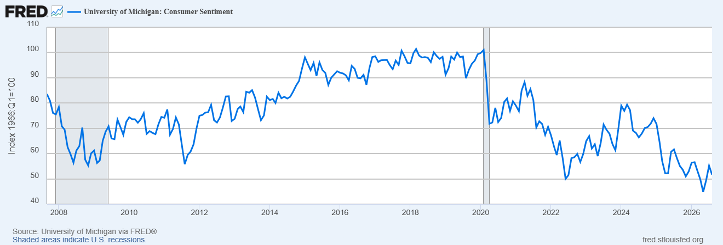
Consumers Are Very Pessimistic
“Vibe” Recession ?

Slide 30
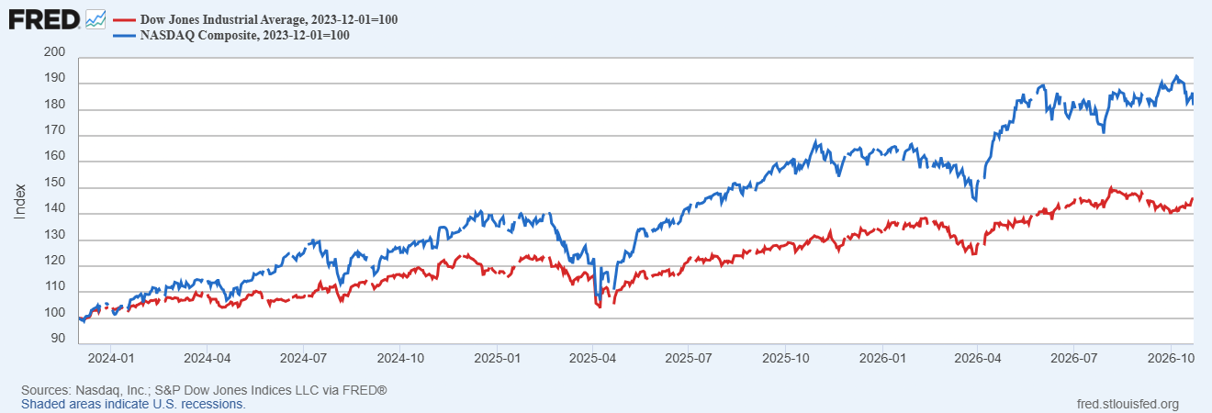
The Stock Market is Being Driven by Tech

Slide 31
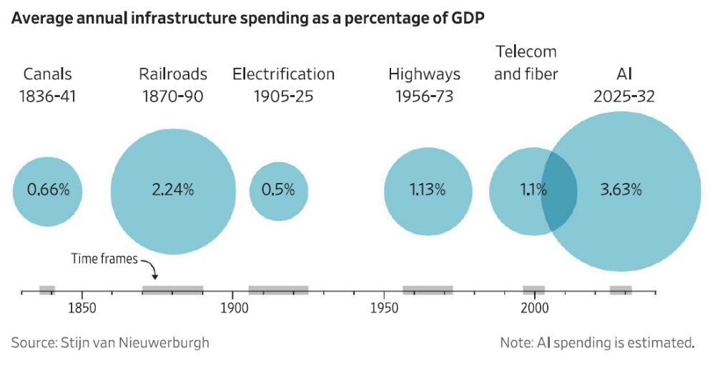
AI Boom is Unprecedented
https://www.brookings.edu/wp-content/uploads/2026/09/4c_Van-Nieuwerburgh.pdf

Slide 32
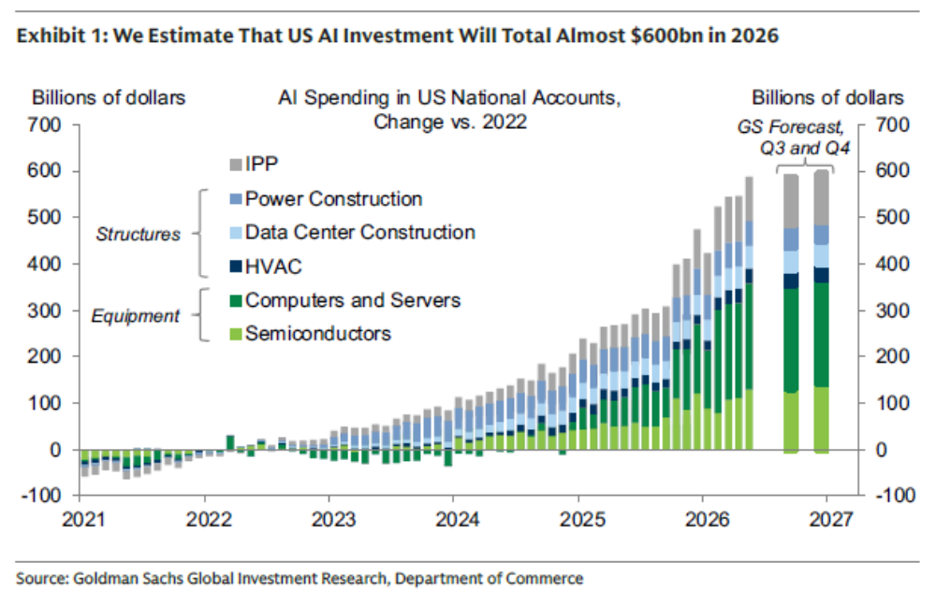
How Important is AI Spending?
2% of GDP
10% of Total Business Fixed Investment
15% Investment in Equipment

Slide 33
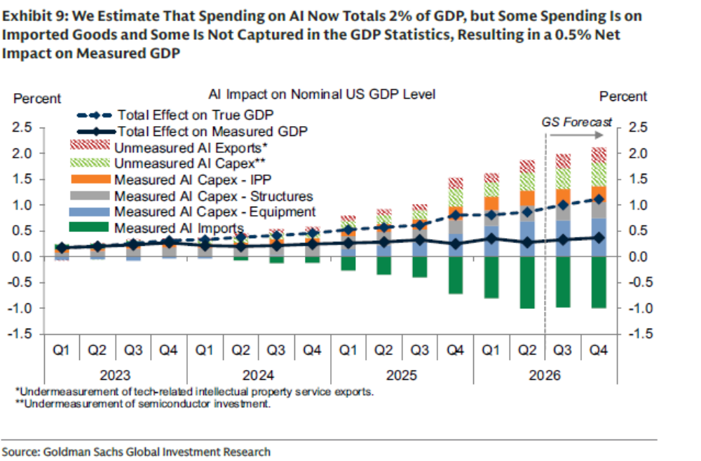
But that Overstates its Effect on GDP

Slide 34
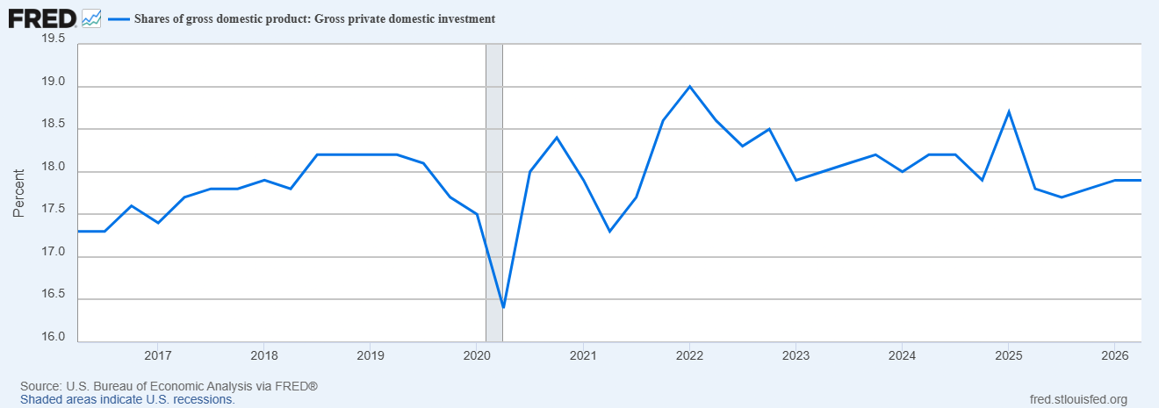
Is AI Spending Crowding out Other Investment?

Slide 35
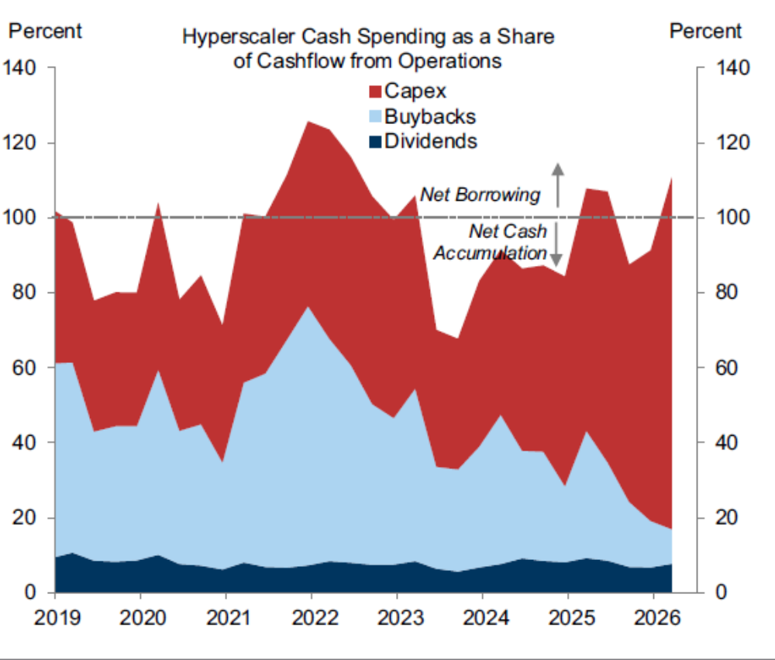
How Will AI Spending Be Financed?
Source: Goldman Sachs

Slide 36
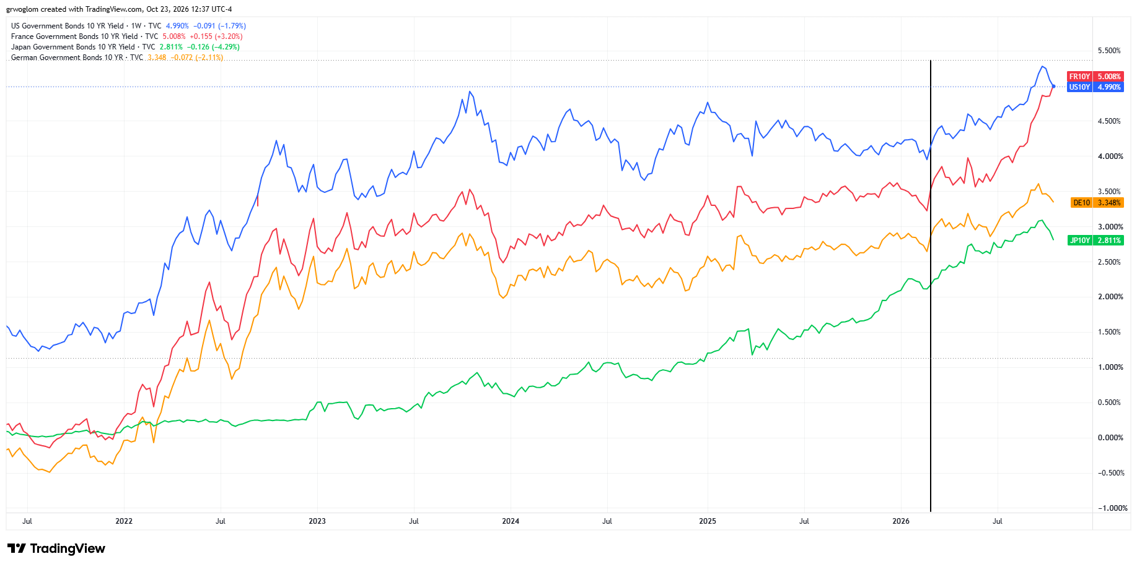
Part 2 Intro: The World-Wide Rise in Rates
Iran War

Slide 37
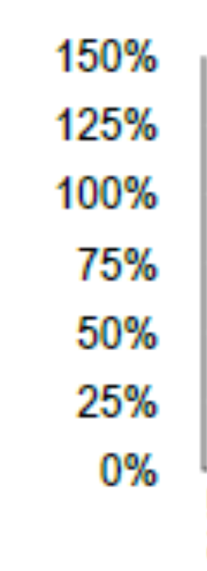
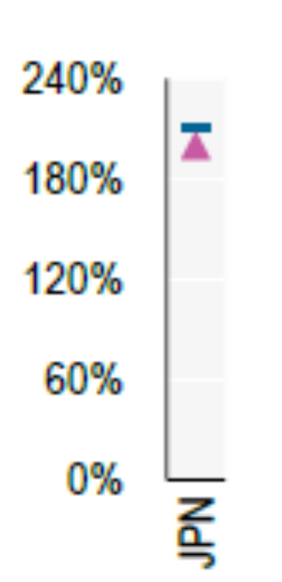
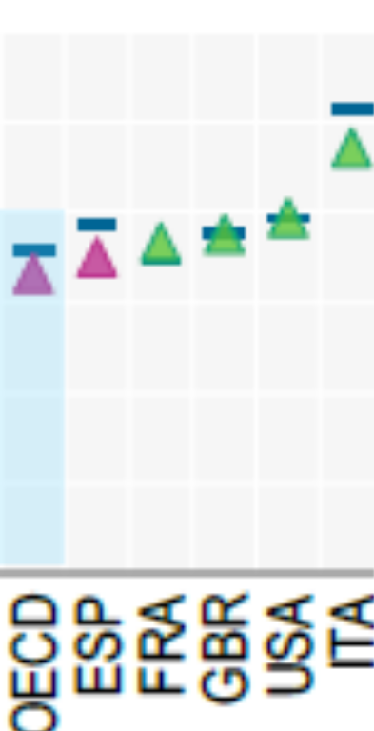
Why Do High Interest Rates Matter?
2025 Levels of Debt to GDP
Effects of 1 pcp increase in interest rates on CBO projections for 2056.
Debt-to-GDP ratio rises from 175% to 222%.
Deficit rises from 9.1% to 14% of GDP.
Interest on the debt rises from 6.9% to 11.4%,at which point it would comprise 60% of total federal revenue.
OECD (2026), Global Debt Report 2026: Sustaining Debt Market Resilience Under Growing Pressure, OECD Publishing, Paris, https://doi.org/10.1787/e9d80efd-en.
Notes:
Fiscal Sustainability

Slide 38
Why Do High Interest Rates Matter 2?
Housing shortage and housing affordability.
WSJ, 10/5 headline: The Surge in Rates is Blowing Up Commercial Real-Estate Deals.
WSJ, 10/8 headline: Rising Rates are Eroding the Value of Even the Most High-Flying Tech Stocks
The Stock Market
https://shillerdata.com/

Slide 39
Key Questions
What Caused the Increase?
Are High Rates Likely to Persist?

Slide 40
Oversimplified Determinants of Interest Rates
The Fed sets “money market” interest rates (maturities less than 6 months).
Interest rates on short-term bonds (1 to 3 years) depend on market expectations of the evolution of money markets rates over the life of the bond.
Longest- term bonds (30 year) mostly reflect expectations of interest rates when the Fed will meet (at least on average) its objectives.

Slide 41
The Federal Funds Rate, the Policy Instrument
The federal funds rate is the interest rate charged on overnight loans of bank reserves between two banks.
The Fed sets a target range for the federal funds rate; currently 3.75% to 4.00%.
If the market federal funds rate rises above 4%, the Fed buys government securities which increases the supply of bank reserves.

Slide 42
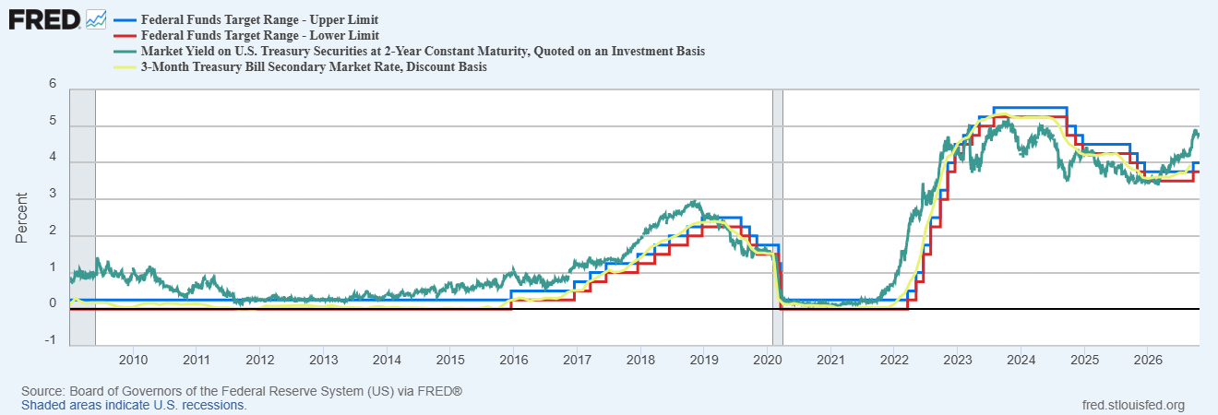
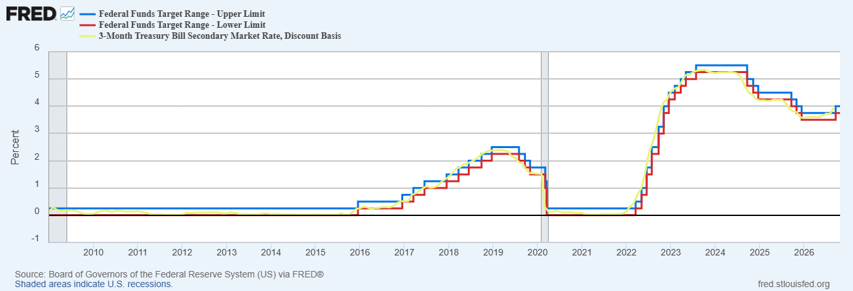
The Fed Essentially Sets the 3-month rate

Slide 43
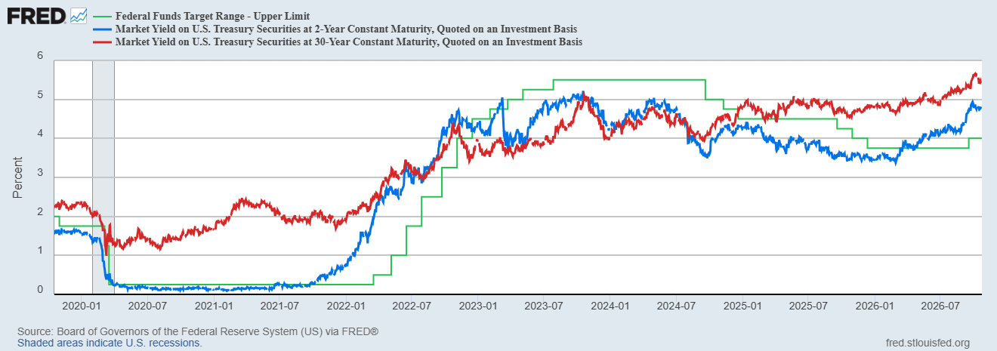
Reading the Interest Rate Tea Leaves

Slide 44
Since the Start of the Iran war
2-yr rate rises (on 3/3) first in anticipation that the Fed would raise the federal funds rate.
30-yr Rates also starts to rise but by less
Fed raises the federal funds rate in September.
1) Short-rates are signaling substantial increase in the federal funds rate in the next year or so.
2) Long-term rates are signaling that a substantial fraction of those increase will persist.

Slide 45
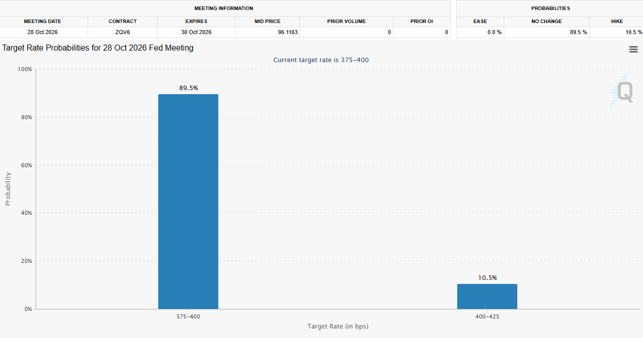
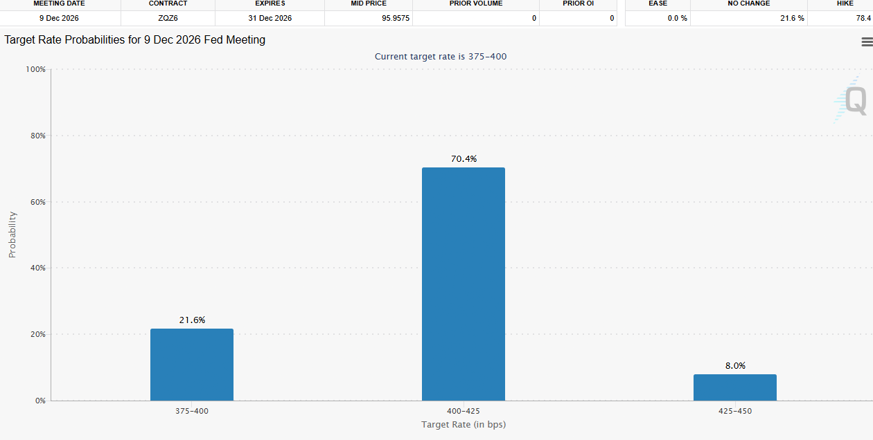
When Will the Fed Act?
Not Before the election.
https://www.cmegroup.com/markets/interest-rates/cme-fedwatch-tool.html

Slide 46
Causes of Permanently Higher Rates
Persistently, high 30-yr interest rates are unlikely to be due to the AI investment boom. More likely, credit markets are signaling that US (and many other developed countries) fiscal debt and deficits are not sustainable.
The Worst-Case Scenario: A run on the dollar.

Slide 47

A Cheerful (?) Final Note:
The crisis takes a much longer time coming than you think,…
and then it happens much faster than you would have thought.
Rudy Dornbusch

Slide 48
My Google Site
https://sites.google.com/view/macro-current-issues/economic-update

Slide 49
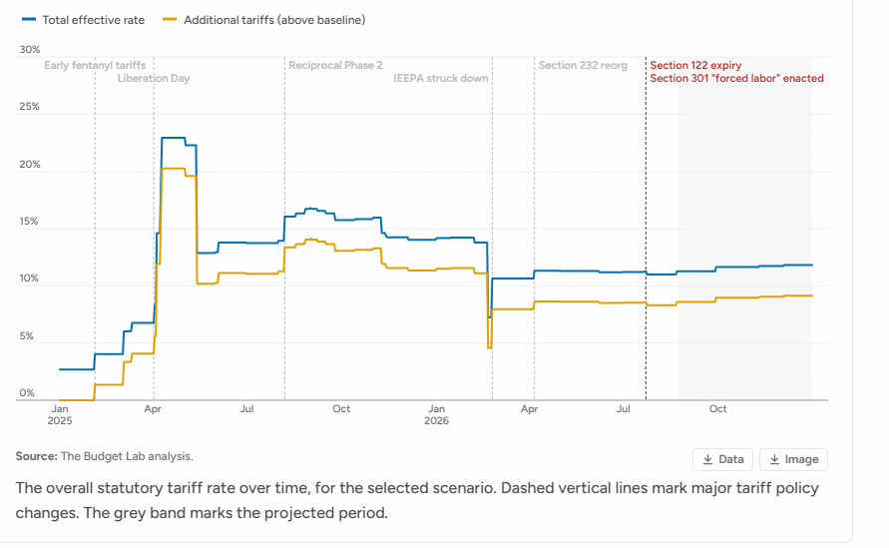
Next Week: Economics of Tariffs
2023
1.2 Million

Slide 50
Let’s Hear from You!
Geoffrey Woglom grwoglom@amherst.edu
Contact NEED: Info@NEEDEcon.org
Support NEED: www.NEEDEcon.org/donate.php

